Slide 1
MATHEMATICS OF CRYPTOGRAPHY PART II Algebraic Structures

Slide 2
ALGEBRAIC STRUCTURES
Cryptography requires sets of integers and specific operations that are defined for those sets.
The combination of the set and the operations that are applied to the elements of the set is called an algebraic structure.
Three common algebraic structures: groups, rings, and fields.

Slide 3
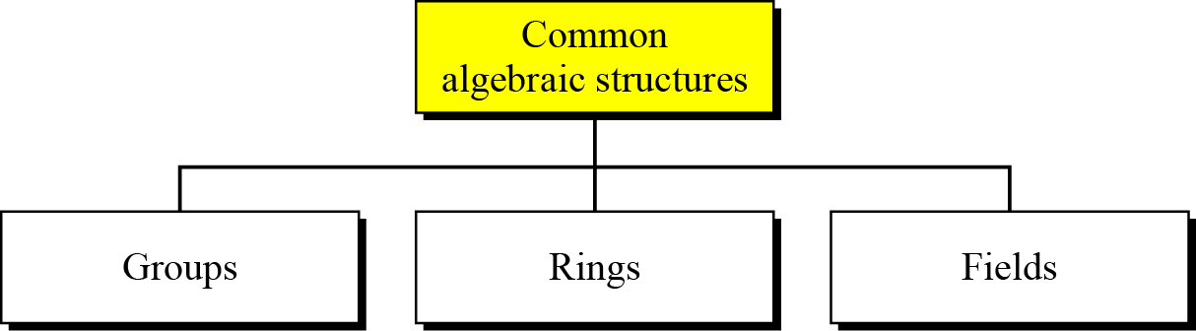
ALGEBRAIC STRUCTURES(cont.)
Common algebraic structure

Slide 4
Groups
A group (G) is a set of elements with a binary operation (•) that satisfies four properties (or axioms).
Closure
Associativity
Existence of identity
Existence of inverse

Slide 5
Groups(cont.)
Closure
If a and b are elements of G, then c = a•b is also an element of G.
Associativity
If a, b and c are elements of G, then (a•b) •c=a•(b•c)
Existence of identity
For all a in G, there exist an element e, called the identity element, such that e•a=a•e=a
Existence of inverse
For each a in G, there exists an element a’, called the inverse of a, such that a•a’=a’•a=e

Slide 6
Groups(cont.)
A Commutative group (Abelian group) is group in which the operator satisfies four properties plus an extra property that is commutativity.
For all a and b in G, we have a • b = b • a

Slide 7
Groups(cont.)
Example
The set of residue integers with the addition operator,
G = < Z_{n} , +>,
is a commutative group.
Check the properties…..

Slide 8
Groups(cont.)
Example:
The set Z_{n}* with the multiplication operator, G = <Z_{n}*, ×>, is also an abelian group.
Example:
Let us define a set G = < {a, b, c, d}, •> and the operation as shown in Table.

Slide 9
Groups(cont.)
Example:
A very interesting group is the permutation group.
The set is the set of all permutations, and the operation is composition: applying one permutation after another.
Check for properties….
Is the group abelian????

Slide 10
Groups(cont.)
Example(cont.):
Operation table for permutation group

Slide 11
Groups(cont.)
In the previous example, we showed that a set of permutations with the composition operation is a group.
This implies that using two permutations one after another cannot strengthen the security of a cipher.
Because we can always find a permutation that can do the same job because of the closure property.

Slide 12
Groups(cont.)
Application
Although a group involves a single operation, the properties imposed on the operation allow the use of a pair of operations!!!!
How???

Slide 13
Groups(cont.)
Finite Group
If the set has a finite number of elements; otherwise, it is an infinite group.
Order of a Group |G|
The number of elements in the group.
If the group is finite, its order is finite
Subgroups
A subset H of a group G is a subgroup of G if H itself is a group with respect to the operation on G

Slide 14
Groups(cont.)
Subgroups(cont.)
If G=<S, •> is a group, H=<T, •> is a group under the same operation, and T is a nonempty subset of S, then H is a subgroup of G
If a and b are members of both groups, then c=a•b is also member of both groups
The group share the same identity element
If a is a member of both groups, the inverse of a is also a member of both groups
The group made of the identity element of G, H=<{e}, •>, is a subgroup of G
Each group is a subgroup of itself

Slide 15
Groups(cont.)
Exercise:
Is the group H = <Z₁₀, +> a subgroup of the group G = <Z₁₂, +>?

Slide 16
Groups(cont.)
Exercise:
Is the group H = <Z₁₀, +> a subgroup of the group G = <Z₁₂, +>?
Solution:
The answer is no. Although H is a subset of G, the operations defined for these two groups are different. The operation in H is addition modulo 10; the operation in G is addition modulo 12.

Slide 17
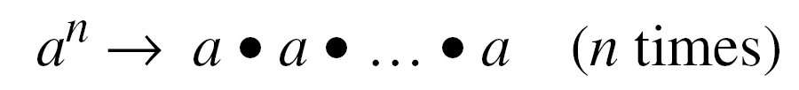
Groups(cont.)
Cyclic subgroups
If a subgroup of a group can be generated using the power of an element, the subgroup is called the cyclic subgroup.

Slide 18

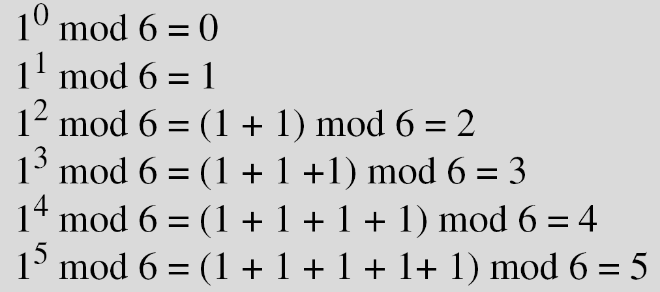
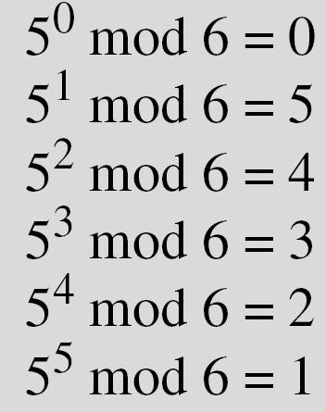
Groups(cont.)
Four cyclic subgroups can be made from the group G = <Z₆, +>.
They are H₁ = <{0}, +>, H₂ = <{0, 2, 4}, +>, H₃ = <{0, 3}, +>, and H₄ = G.

Slide 19
Groups(cont.)
Exercise:
Find out the cyclic subgroups for group G = <Z₁₀∗, ×>.

Slide 20
Groups(cont.)
Three cyclic subgroups can be made from the group G = <Z₁₀∗, ×>. G has only four elements: 1, 3, 7, and 9. The cyclic subgroups are H₁ = <{1}, ×>, H₂ = <{1, 9}, ×>, and H₃ = G.

Slide 21
Groups(cont.)
Cyclic group
A cyclic group is a group that is its own cyclic subgroup.

Slide 22
Groups(cont.)
Cyclic group(cont.)
Example:
Three cyclic subgroups can be made from the group G = < Z₁₀∗, ×>.
The cyclic subgroups are H₁ = <{1}, ×>, H₂ = <{1, 9}, ×>, and H₃ = G.
The group G = <Z₁₀∗, ×> is a cyclic group with two generators, g = 3 and g = 7.
The group G = <Z₆, +> is a cyclic group with two generators, g = 1 and g = 5.

Slide 23
Groups(cont.)
Lagrange’s Theorem
Assume that G is a group, and H is a subgroup of G. If the order of G and H are |G| and |H|, respectively, then, based on this theorem, |H| divides |G|.
Order of an Element
The order of an element is the order of the cyclic group it generates.

Slide 24
Groups(cont.)
Example:
In the group G = <Z₆, +>, the orders of the elements are:
ord(0) = 1, ord(1) = 6, ord(2) = 3, ord(3) = 2, ord(4) = 3, ord(5) = 6.
In the group G = <Z₁₀*, ×>, the orders of the elements are: ord(1) = 1, ord(3) = 4, ord(7) = 4, ord(9) = 2.

Slide 25
Ring
A ring, R = <{…}, •, >, is an algebraic structure with two operations.
First operation must satisfy all five properties
Second operation must satisfy only the first two
In addition, second operation must be distributed over first
i.e. for all a, b, and c elements of R, we have,
a (b • c) = (a b) • (a c) and
(a • b) c = (a c) • (a c)

Slide 26
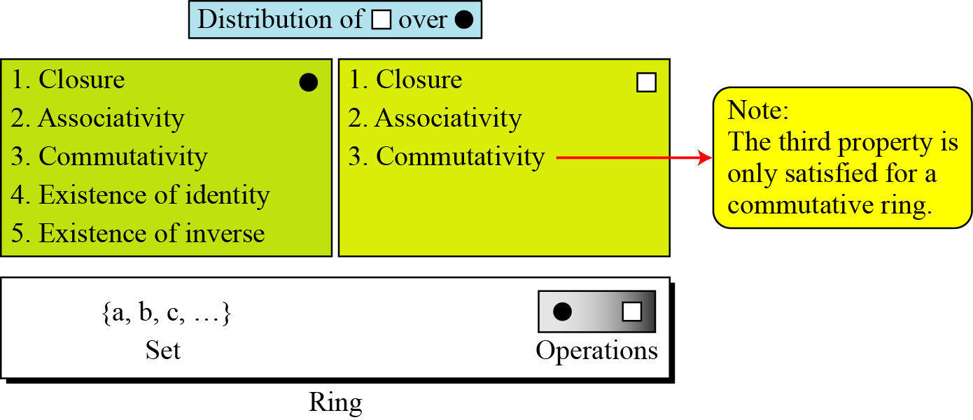
Ring(cont.)
Commutative Ring

Slide 27
Ring(cont.)
The set Z with two operations, addition and multiplication, is a commutative ring.
We show it by R = <Z, +, ×>.
Addition satisfies all of the five properties; multiplication satisfies only three properties.

Slide 28
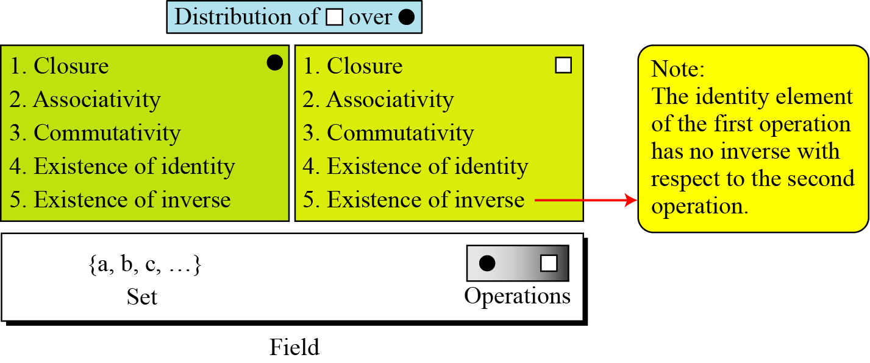
Field
A field, denoted by F = <{…}, •, > is a commutative ring in which the second operation satisfies all five properties defined for the first operation except that the identity of the first operation has no inverse.

Slide 29
Field(cont.)
Finite Fields
Galois showed that for a field to be finite, the number of elements should be p^{n}, where p is a prime and n is a positive integer.
A Galois field, GF(p^{n}), is a finite field with p^{n} elements.

Slide 30
Field(cont.)
GF(p) Fields
When n = 1, we have GF(p) field.
This field can be the set Z_{p}, {0, 1, …, p − 1}, with two arithmetic operations.

Slide 31
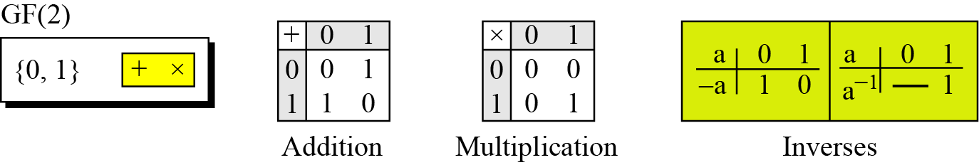
Field(cont.)
A very common field in this category is GF(2) with the set {0, 1} and two operations, addition and multiplication.
GF(2) field

Slide 32
Field(cont.)
We can define GF(5) on the set Z₅ (5 is a prime) with addition and multiplication operators.

Slide 33
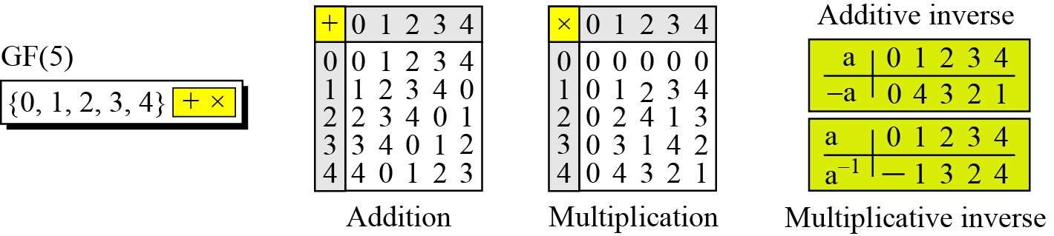
Field(cont.)
We can define GF(5) on the set Z5 (5 is a prime) with addition and multiplication operators.
GF(5) field

Slide 34
Summary:

Slide 35
GF(2^{n}) FIELDS
In cryptography, we often need to use four operations(addition, subtraction, multiplication and division).
In other words, we need to use fields.
However, when we work with computers, the positive integers are stored in the computers as n-bit words in which n is usually 8,16,32 and so on.
Range of integers is 0 to 2^{n} – 1
Hence modulus is ?????
What if we want to use field????

Slide 36
GF(2^{n}) FIELDS (cont.)
Solution 1
Use GF(p), with the set Zp, where p is the largest prime number less than 2^{n}
But the problem ???
Solution 2
Use GF(2^{n})
Use a set of 2^{n} words
The elements in this set are n-bit words
E.g. for n=3, the set is {000,001,010,011,100,101,110,111}

Slide 37
GF(2^{n}) FIELDS (cont.)
Solution 2
But the problem???

Slide 38
GF(2^{n}) FIELDS (cont.)
Solution 2
But the problem???
2^{n} is not prime
Need to define operations on the set of elements in GF(2^{n})

Slide 39
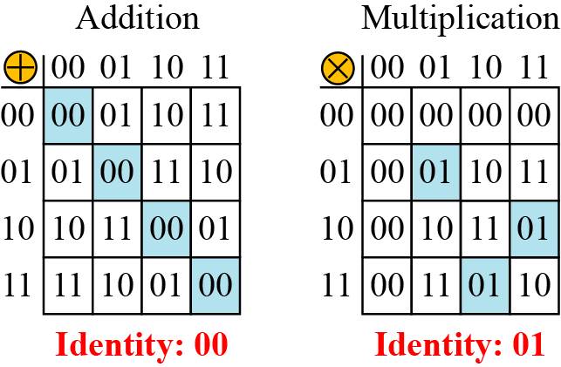
GF(2^{n}) FIELDS (cont.)
Let us define a GF(2²) field in which the set has four 2-bit words: {00, 01, 10, 11}.
We can redefine addition and multiplication for this field in such a way that all properties of these operations are satisfied.
An example of GF(2²) field

Slide 40
Polynomials
A polynomial of degree n − 1 is an expression of the form
where x^{i} is called the ith term and a_{i} is called coefficient of the ith term.

Slide 41
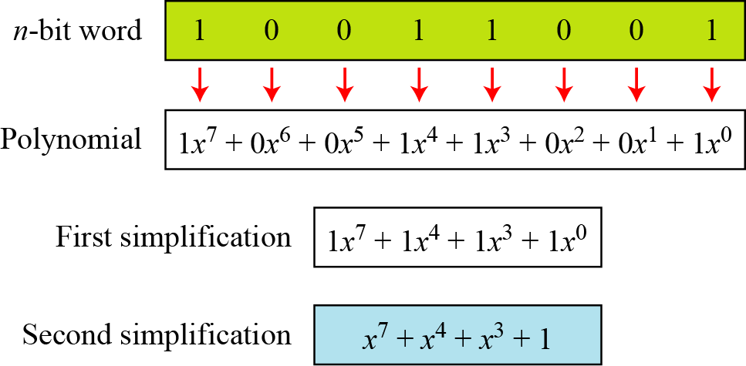
Polynomials (cont.)
We can represent the 8-bit word (10011001) using a polynomial.

Slide 42
Polynomials (cont.)
Find the 8-bit word related to the polynomial x⁵ + x² + x, we first supply the omitted terms.
Since n = 8, it means the polynomial is of degree 7. The expanded polynomial is,
This is related to the 8-bit word 00100110.

Slide 43
Polynomials (cont.)
Operations on polynomials
Actually involves two operations
Operation on coefficients and operation on polynomials
Hence, need to define two fields
What for coefficient??
What for polynomials???

Slide 44
Polynomials (cont.)
Operations on polynomials
Actually involves two operations
Operation on coefficients and operation on polynomials
Hence, need to define two fields
What for coefficient??
What for polynomials???
GF(2) and GF(2^{n}) is the answer….

Slide 45
Polynomials (cont.)
Modulus
For the sets of polynomials in GF(2^{n}), a group of polynomials of degree n is defined as the modulus.
Such polynomials are referred to as irreducible polynomials.

Slide 46
Polynomials (cont.)
irreducible polynomials.
No polynomial in the set can divide this polynomial
Can not be factored into a polynomial with degree of less than n

Slide 47
Polynomials (cont.)
Polynomial addition
Addition and subtraction operations on polynomials are the same operation.

Slide 48
Polynomials (cont.)
Example
Let us do (x⁵ + x² + x) ⊕ (x³ + x² + 1) in GF(2⁸). We use the symbol ⊕ to show that we mean polynomial addition. The following shows the procedure:

Slide 49
Polynomials (cont.)
Short cut method
Addition in GF(2) means the exclusive-or (XOR) operation.
So we can exclusive-or the two words, bits by bits, to get the result.
In the previous example, x⁵ + x² + x is 00100110 and x³ + x² + 1 is 00001101.
The result is 00101011 or in polynomial notation x⁵ + x³ + x + 1.

Slide 50
Polynomials (cont.)
Multiplication
The coefficient multiplication is done in GF(2).
The multiplying x^{i} by x^{j} results in x^{i+j}.
The multiplication may create terms with degree more than n − 1, which means the result needs to be reduced using a modulus polynomial.

Slide 51
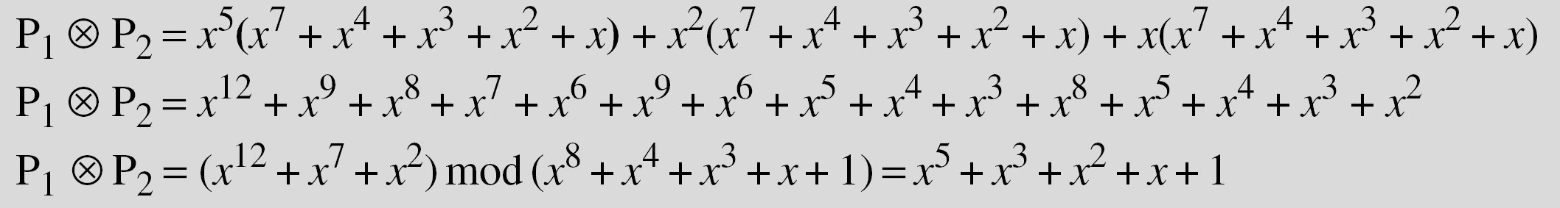
Polynomials (cont.)
Example
Find the result of (x⁵ + x² + x) ⊗ (x⁷ + x⁴ + x³ + x² + x) in GF(2⁸) with irreducible polynomial (x⁸ + x⁴ + x³ + x + 1).
To find the final result, divide the polynomial of degree 12 by the polynomial of degree 8 (the modulus) and keep only the remainder.

Slide 52
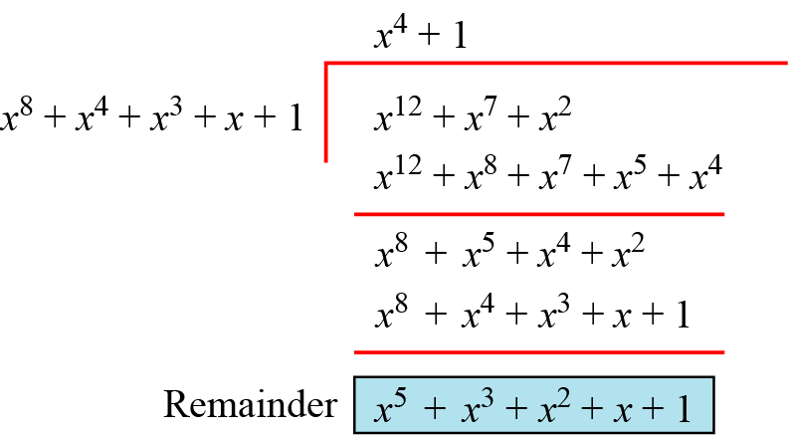
Polynomials (cont.)
Polynomial division with coefficients in GF(2)

Slide 53
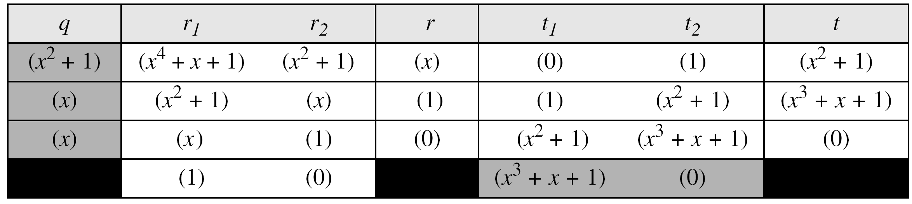
Polynomials (cont.)
Example:
In GF (2⁴), find the inverse of (x² + 1) modulo (x⁴ + x + 1).
Solution
The answer is (x³ + x + 1)

Slide 54
Polynomials (cont.)
Example:
In GF(2⁸), find the inverse of (x⁵) modulo (x⁸ + x⁴ + x³ + x + 1).

Slide 55
Polynomials (cont.)
Example:
In GF(2⁸), find the inverse of (x⁵) modulo (x⁸ + x⁴ + x³ + x + 1).
Solution

Slide 56
Polynomials (cont.)
A better algorithm for polynomial multiplication:
Obtain the result by repeatedly multiplying a reduced polynomial by x.
Example:
Find the result of multiplying P₁ = (x⁵ + x² + x) by P₂ = (x⁷ + x⁴ + x³ + x² + x) in GF(2⁸) with irreducible polynomial (x⁸ + x⁴ + x³ + x + 1)

Slide 57
Polynomials (cont.)
Solution:
We first find the partial result of multiplying x⁰, x¹, x², x³, x⁴, and x⁵ by P₂. Note that although only three terms are needed, the product of x^{m} ⊗ P₂ for m from 0 to 5 because each calculation depends on the previous result.

Slide 58
Polynomials (cont.)
Exercise:
Find the result of multiplying P₁ = (x³ + x² + x + 1) by P₂ = (x² + 1) in GF(2⁴) with irreducible polynomial (x⁴ + x³ + 1)

Slide 59
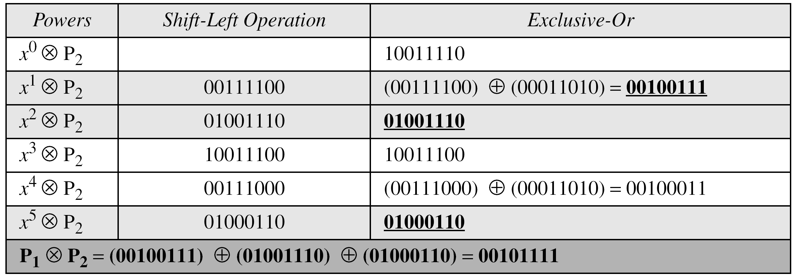
Multiplication using computer
We have P1 = 000100110, P2 = 10011110, modulus = 100011010 (nine bits). We show the exclusive or operation by ⊕.

Slide 60
Polynomials (cont.)
Exercise:
Find the result of multiplying (10101) by (10000) in GF(2⁵) using (x⁵ + x² + 1) as modulus.

